Slide 1

Bank Customer Churn
Grant Pennington

Slide 2

The Dataset I used is titled Bank Customer Churn. Bank Customer data for predicting customer churn. This dataset was created for ABC Multinational Bank and the goal is to predict if customers might leave their bank.
The target column was churn.
0 for if the customer had not left the bank before.
1 if they had left the bank before

Slide 3
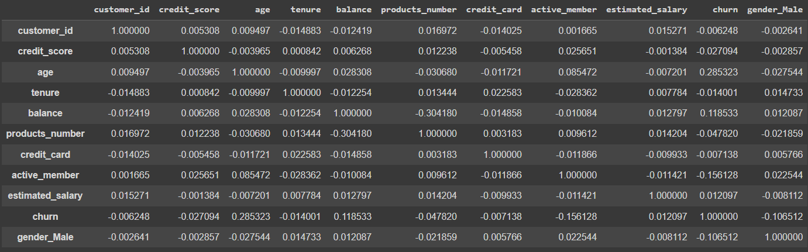
Correlation Matrix
The columns did not correlate highly to the target column (churn)

Slide 4
The models used to test against the dataset:
1. Logistic Regression
2. SVC
3. Decision Tree Classifier
4. Random Forest Classifier
I used the Voting Classifier to depict the best model to use.

Slide 5
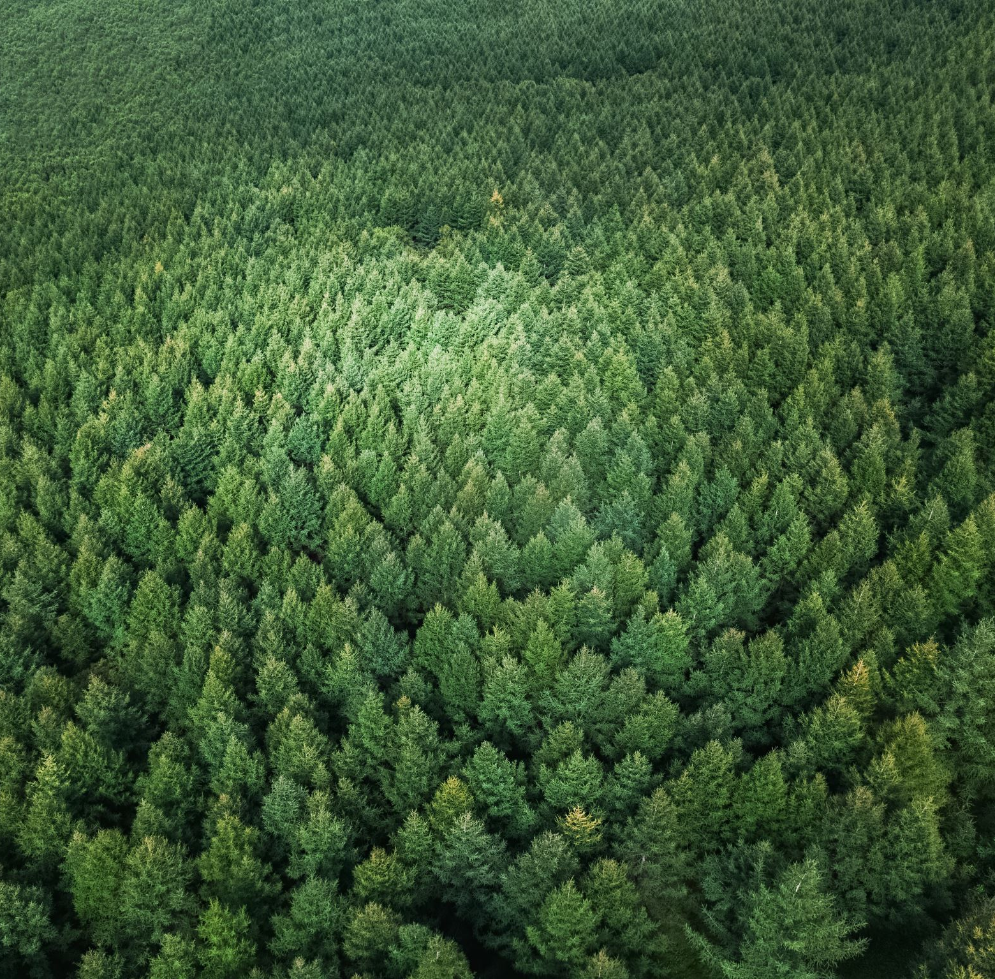
Results
The Voting Classifier found that the Random Forest Classifier was the best model with a score of 0.857
The RMSE was 0.373.

Slide 6
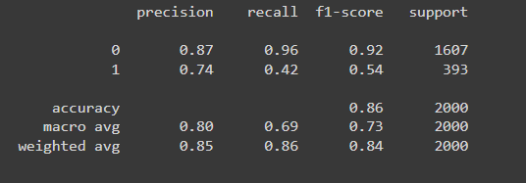
Precision, recall, and F1 scores

